Slide 1
EIGRP
Course Code: CSC 3116
Course Title: Computer Networks
Dept. of Computer Science
Faculty of Science and Technology
Lecturer No: | Lab 7 | Week No: | 7 | Semester: | Fall 2021-22

Slide 2
Lecture Outline
Introduction
Metric
Neighbor Discovery
EIGRP Tables
EIGRP Tables
EIGRP Configuration

Slide 3
Introduction
RIP-vs_EIGRP
 | RIP | EIGRP
1 | It support maximum 15 routers in the network. 16 router is unreachable. | It supports maximum 255 routers in the network. However, the default is 100 routers. (highly scalable)
2 | Slow convergence | Fast convergence due to feasible successor
3 | In RIP routing protocol, we cannot create a separate administrative boundary in the network. | In EIGRP routing protocol we can create a separate administrative boundary in the network with the help of autonomous system No. Less routing Table exchange is required.
4 | It calculates the metric In terms of Hop Count from source network to destination network. | It calculates the metric In terms of bandwidth and delay (default).
5 | RIP works on Bellman Ford algorithm. | EIGRP works on DUAL(Diffusing Update Algorithm) Algorithm.
6 | It only maintains the best route to each destination. | It maintains the best route and some other alternative routes for each destination.
7 | It is basically use for smaller size organization. | It is basically use for medium to lager size organization in the network [1].

Slide 4
Metric
Combination of different factors
  Bandwidth
  Delay
  Load
  Reliability
Default

Slide 5
Metric….
Bandwidth
  No. of bits that can be sent over a link (kbps)
  Depends on interface type
  Use bandwidth <1-10,000,000> command to set bandwidth in kbps
  This is not real bandwidth; real bandwidth depends on clock rate
  The bandwidth command only influence route selection by routing protocol
  If no bandwidth is set, the default bandwidth of an interface is considered
  Calculated as the lowest bandwidth among all links in a route

Slide 6
Metric….
Table II Default bandwidth and delay
Interface | Bandwdith | Delay (microseconds)
Serial (T1) | 1544 Kbps | 20,000
Ethernet | 10 Mbps | 1000
Fast Ethernet | 100 Mbps | 100
Gigbit Ethernet | 1000 Mbps | 10
10 Gigbit Ethernet | 10 Gbps | 10

Slide 7
Metric….
Delay
  Delay is a measure of the time for a packet to reach its destination over a route (In theory)
  In practice, it is a constant set by the network engineer
  To set delay for an interface, use delay <value> command
  The value can be anything between 10 to 167,772,140 microseconds
  If it is not set, the default value (Table II) of each interface comes into effect
  Calculated as sum of delays in exit interfaces of all routers in a route.

Slide 8
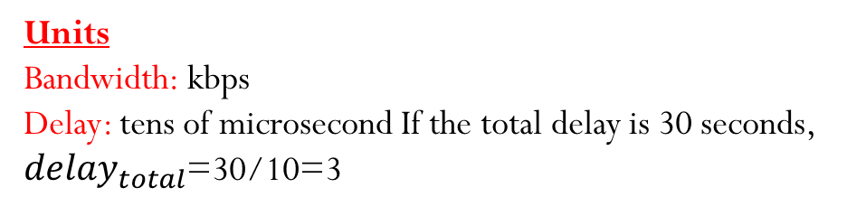
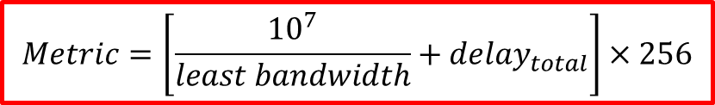
Metric….
Metric calculation
$$Metric=\left[\frac{{10}^{7}}{least bandwidth}+{delay}_{total}\right]×256$$
Units
Bandwidth: kbps
Delay: tens of microsecond If the total delay is 30 seconds, ${delay}_{total}$=30/10=3

Slide 9
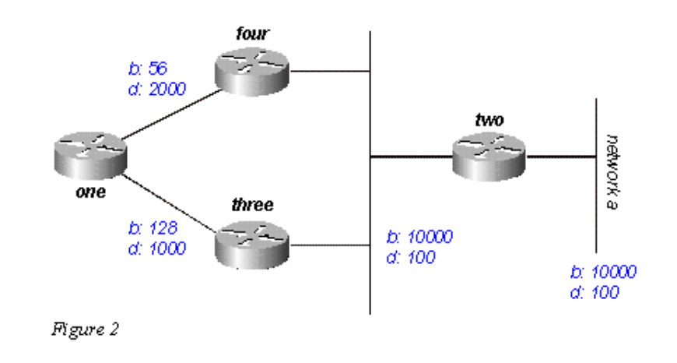





Metric….
Metric calculation
$$Metric=\left[\frac{{10}^{7}}{least bandwidth}+{delay}_{total}\right]×256$$
Route: 1-4-2-B
$$Least BW=56 kbps$$
$$Total delay=100/10+100/10+2000/10=220$$
$Metric=\left[\frac{{10}^{7}}{56}+220\right]×256=45770496$*
Route: 1-3-2-B
$$Least BW=128 kbps$$
$$Total delay=100/10+100/10+1000/10=120$$
$Metric=\left[\frac{{10}^{7}}{128}+120\right]×256=$20030720
Fig. 1 A sample network [2]
Perform rounding in every steps of calculation

Slide 10
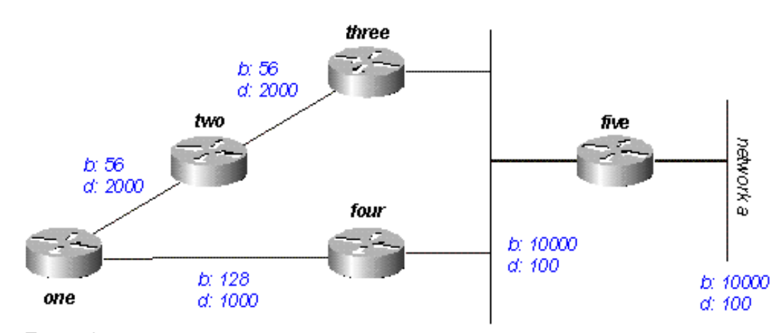
Homework
Calculate metric for all possible routes from router ONE to network A
Fig. 2 A sample network [2]

Slide 11
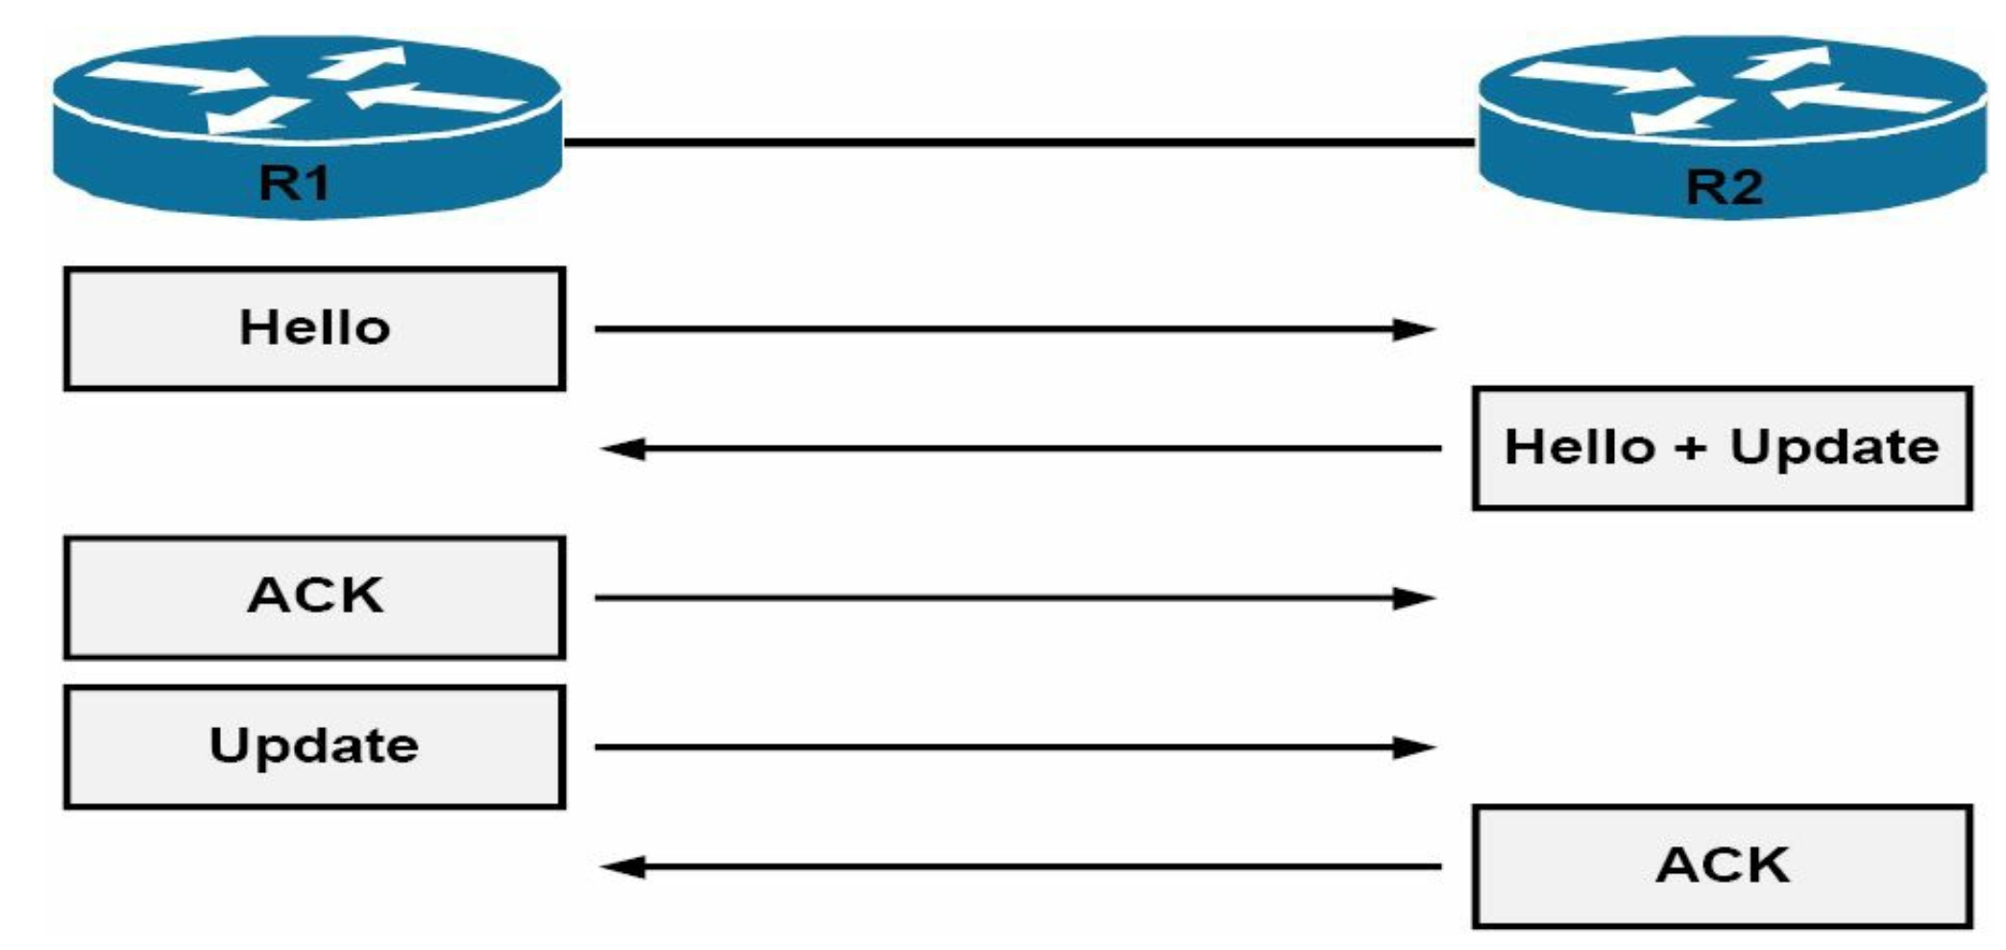
Neighbor discovery
Hello, how are you? Can we be neighbors?
My AS No. and K-values are so and so….
Dest.
224.0.0.10
10.1.1.1
10.1.1.2
Dest.
10.1.1.1
Our AS no. and k-values have matched?
Here is my full routing table.
Dest.
10.1.1.2
I have received our routing table. Thanks
Dest.
10.1.1.2
Here is my full routing table.
Dest.
10.1.1.1
I have received our routing table. Thanks
Fig. 3 Neighbor discovery [3]

Slide 12
Neighbor maintenance
In neighbor discovery process, full routing table is sent
Otherwise, only the change in routing table is sent
After a neighbor discovery, the Hello packet is sent in every 5 second
to know if the neighbor is still alive
If a router does not receive any Hello packet from a neighbor within 15 seconds (called hold time), the neighbor is considered dead.
For low-bandwidth link (e.g., T1), the periods are 60 sec and 180 sec.

Slide 13
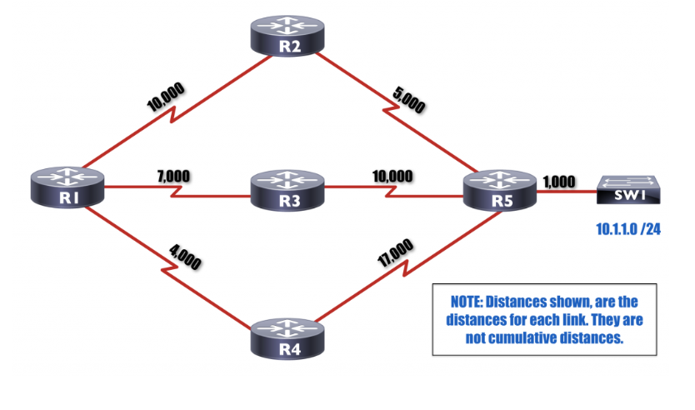
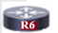

EIGRP Tables….
Feasibility condition: reported distance must
be less than the feasible distance through the successor
Reported distance:
Distance advertised from neighbor
as the distance between the
Neighbor and the destination.
1000
3000
Feasible distance (FD):
Sum of Reported distance and
distance between the router and
the neighbor which reports
the distance.
A feasible successor is the route whose
reported distance is less than the
feasible distance of the best path.

Slide 14
EIGRP Tables
Neighbor Table
  EIGRP shares routing information only with neighbors. To know who the neighbors are, it uses neighbor table. When a new neighbor is discovered, EIGRP would add its address and interface on which neighbor is connected in neighbor table [4].
Topology Table
  Stores all feasible successors along with the successor (best route) for each destination network. EIGRP can store up to 32 feasible successors.
Routing Table
  EIGRP stores single best route for each destination in this table. Router uses this table to forward the packet.

Slide 15

EIGRP Configuration
172.16.1.0/30
192.168.2.0/24
172.16.1.4/30
Autonomous system no.
RIP v2
R1(config)# router rip
R1(config-router)# version 2
R1(config-router)#network 172.16.1.0
R1(config-router)#network 172.16.1.4
R1(config-router)#network 192.168.2.0
R1(config-router)#no auto-summary
EIGRP
R1(config)# router eigrp <1 -65535>
R1(config-router)#network 172.16.1.0 255.255.255.252
R1(config-router)#network 172.16.1.4 255.255.255.252
R1(config-router)#network 192.168.2.0 255.255.255.0
R1(config-router)#no auto-summary

Slide 16
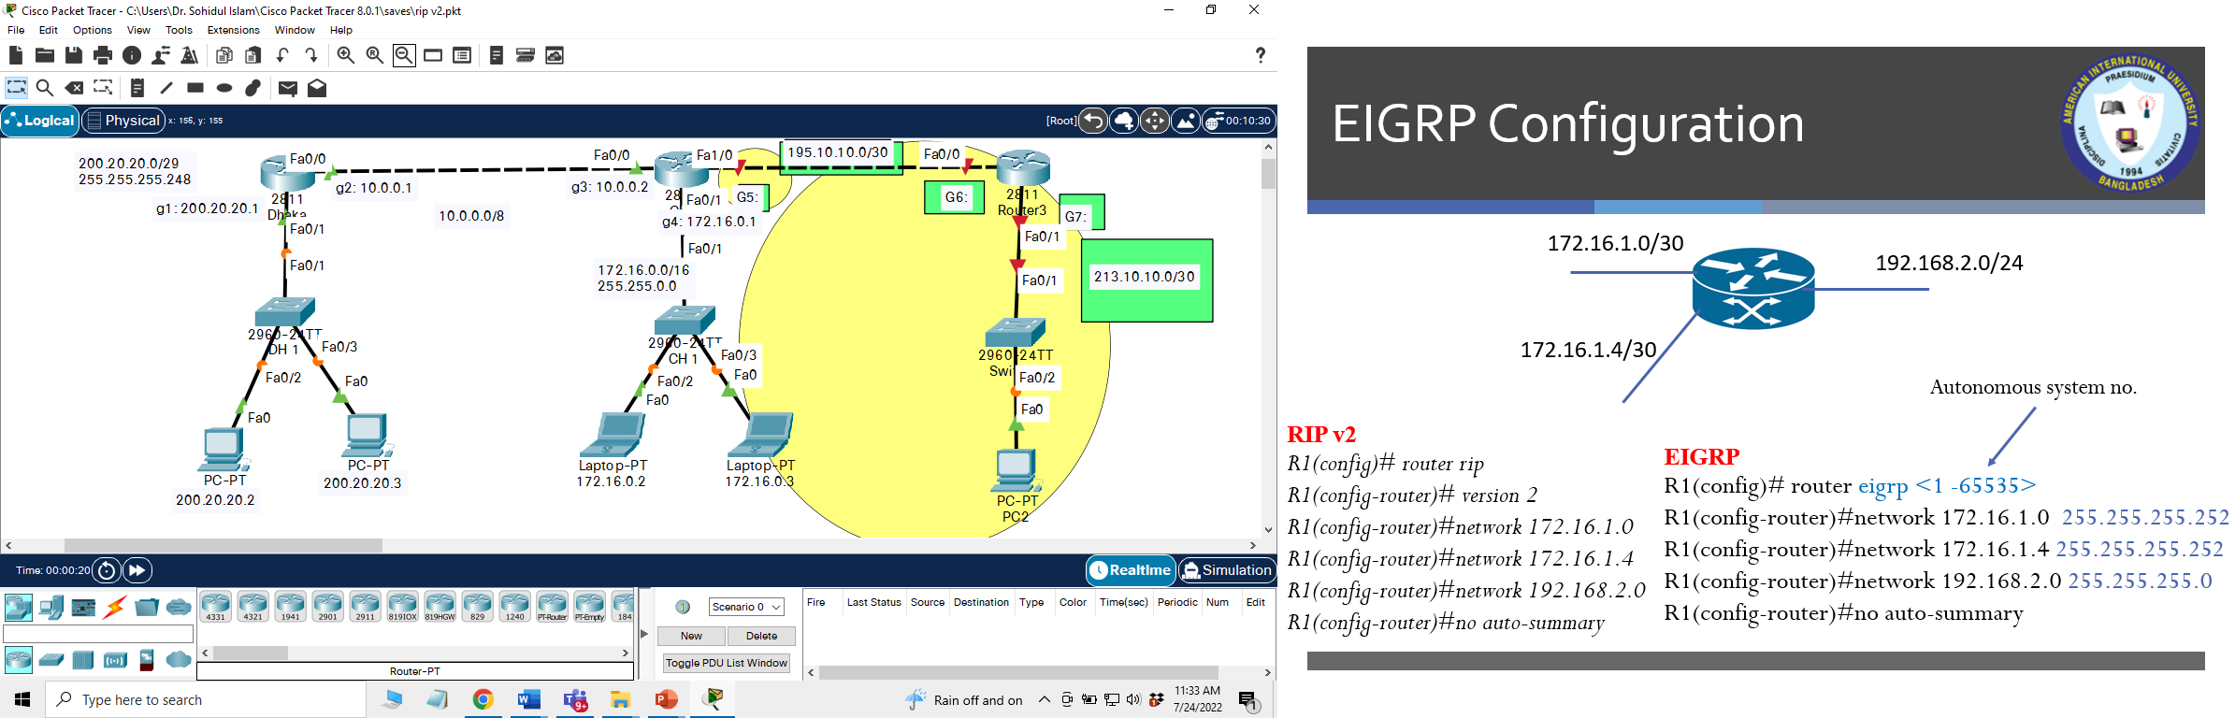

Slide 17
EIGRP Configuration….
To show protocol properties
  show ip protocols
To show neighbor table
  show ip eigrp neighbor
To show topology table
  show ip eigrp topology
To show routes made by eigrp
  show ip route eigrp
To set maximum hops
  metric maximum-hops <1-255>
To set the number of feasible successors
  maximum-paths <0-32>

Slide 18
References
[1] Computer Networking Class, https://computernetworkingclass.blogspot.com...
/2016/08/comparison-between-rip-eigrp-igrp-and.html, [Accessed: April. 27, 2020].
[2] Cisco, “https://www.cisco.com/c/en/us/support/docs/ip/enhanced-interior...
-gateway-routing-protocol-eigrp/16406-eigrp-toc.html, [Accessed: April. 27, 2020].
[3] P. Browning, F. Tafa, D. Gheorghe, and D. Barinic, Cisco CCNA in 60 Days,
Reality Press Ltd., UK, 2014, pp. 581
[4] Computer Networking Notes, https://www.computernetworkingnotes.com/ccna...
-study-guide/eigrp-tutorial-basic-concept-explained.html, [Accessed: April. 27, 2020].

Slide 19
Recommended Books
  Official Cert Guide CCNA 200-301 , vol. 1, W. Odom, Cisco Press, First Edition, 2019, USA.
  CCNA Routing and Switching, T. Lammle, John Wily & Sons, Second Edition, 2016, USA.

